Slide 1
Status update:
2017 CMV Data and
2016 Adjustments
June 2019

Slide 2
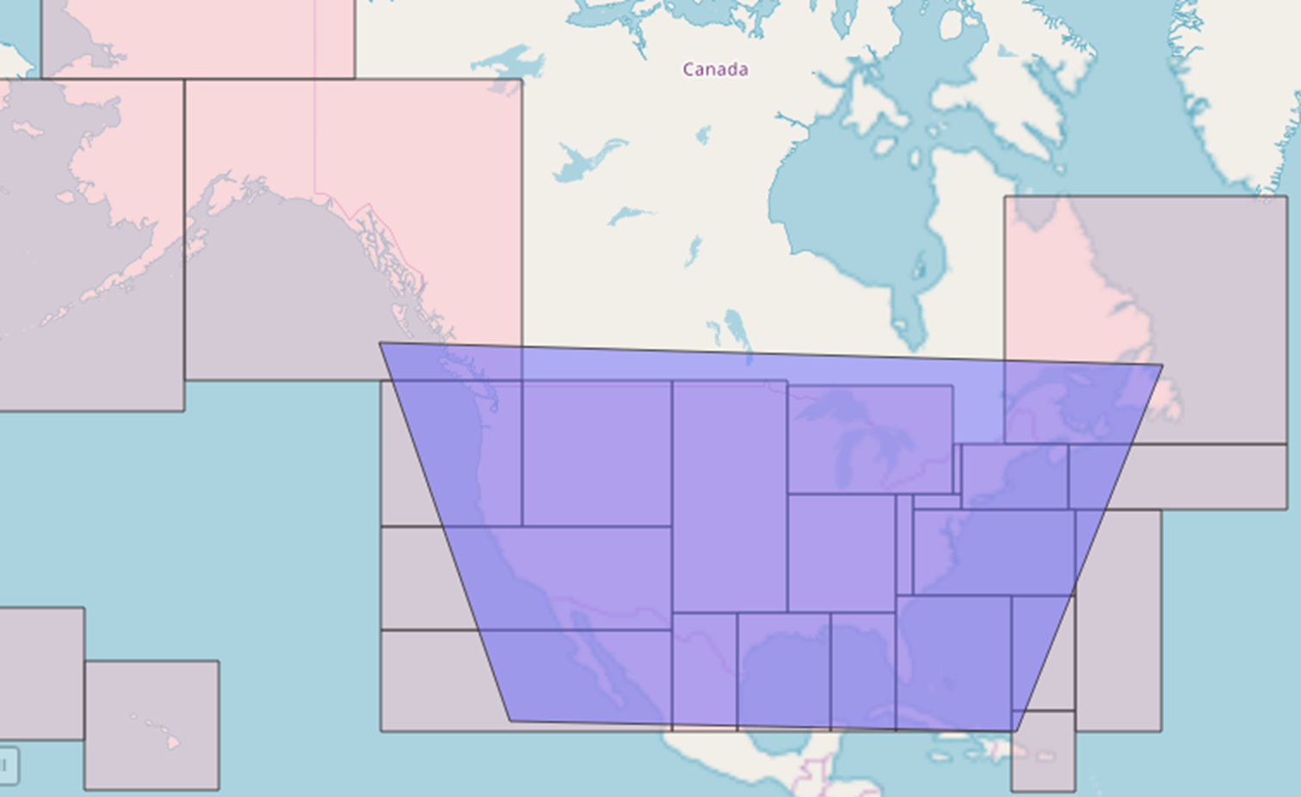
C3 Recap
AIS data were
pulled from the
areas in pink:
The data will
be used for
2017 NEI
C3 CMV model based on 2017 AIS data was completed October 2018
QA checks completed February 2019
Documentation completed December 2018
Separate hourly data files were generated for Rasterization
2017 Category 3 emissions for extended area (tons/year)

Slide 3
New CMV SCCs
New SCC | Fuel | Category | Port/ Underway | Engine
2280002101 | Diesel | C1/C2 | Port | Main
2280002102 | Diesel | C1/C2 | Port | Aux
2280002201 | Diesel | C1/C2 | Underway | Main
2280002202 | Diesel | C1/C2 | Underway | Aux
2280002103 | Diesel | C3 | Port | Main
2280002104 | Diesel | C3 | Port | Aux
2280002203 | Diesel | C3 | Underway | Main
2280002204 | Diesel | C3 | Underway | Aux
2280003103 | Residual | C3 | Port | Main
2280003104 | Residual | C3 | Port | Aux
2280003203 | Residual | C3 | Underway | Main
2280003204 | Residual | C3 | Underway | Aux

Slide 4
2017 to 2016 adjustments
Ship Type | Annual Percent Difference Between National 2016 to 2017 E&C Records
Barge | 64.5%
Bulk Carrier | 93.7%
Chemical Tanker | 97.0%
Container Ship | 96.7%
Cruise | 99.2%
Ferry Ro Pax | 70.0%
General Cargo | 112.7%
Liquified Gas Tanker | 83.9%
Miscellaneous Fishing | 107.3%
Miscellaneous Other | 98.5%
Offshore | 116.3%
Oil Tanker | 90.8%
Other Tanker | 96.4%
Reefer | 115.3%
Ro Ro | 99.3%
Service Tug | 93.1%
Yacht | Inf
Entrance and Clearance summary
  Considered port & National/vessel type adjustments
  Recommended:
    National data could be applied to port & underway operations for most of the C3 types
    use an aggregate adjustment of 98% for C3 Yacht, tug, Barge, Fishing, and C1/2

Slide 5
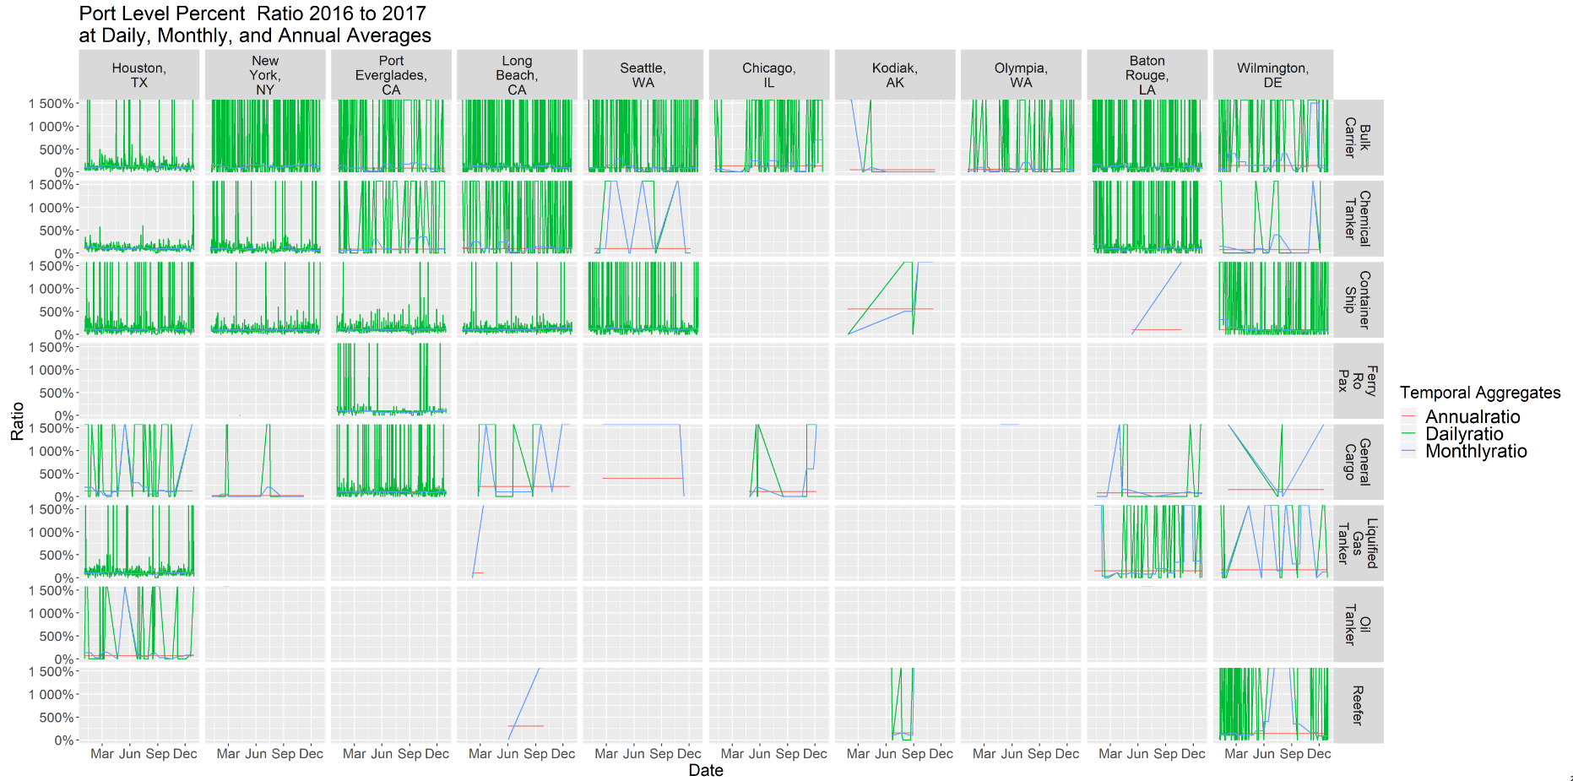

Slide 6
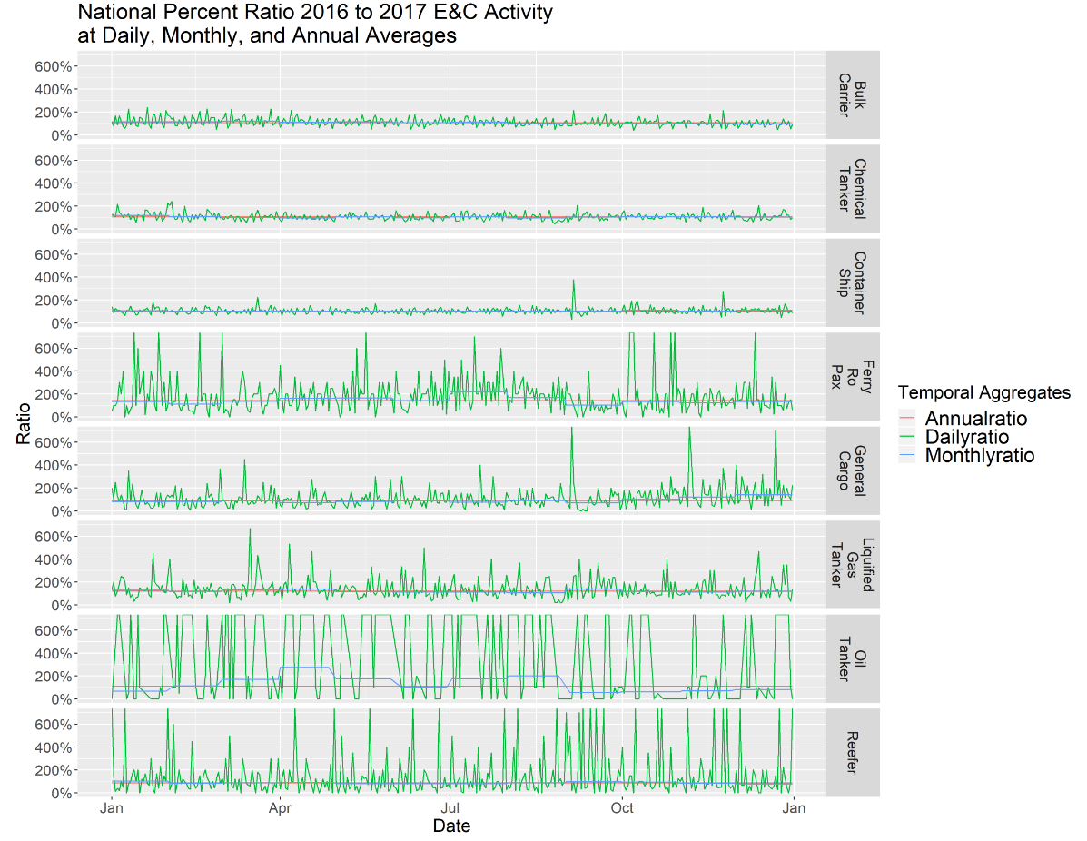

Slide 7
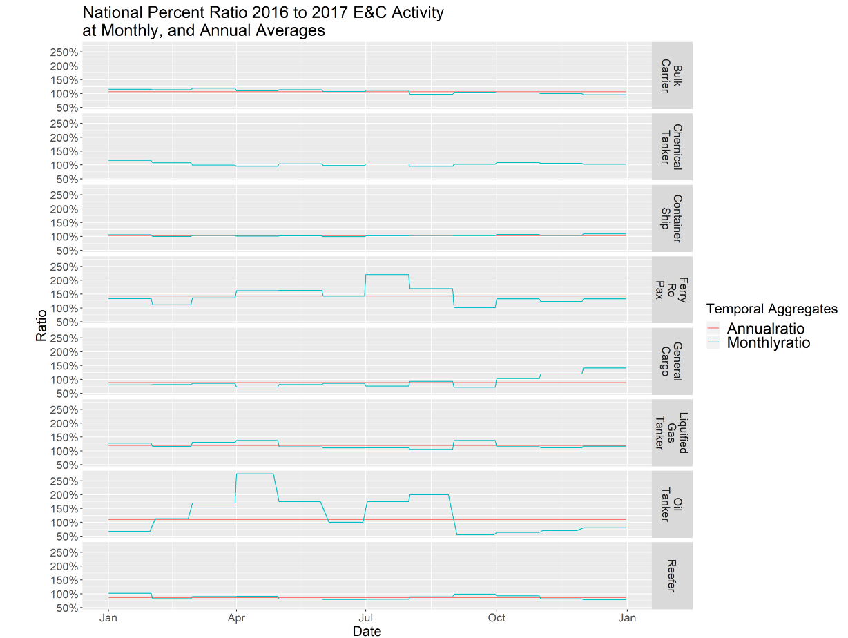

Slide 8
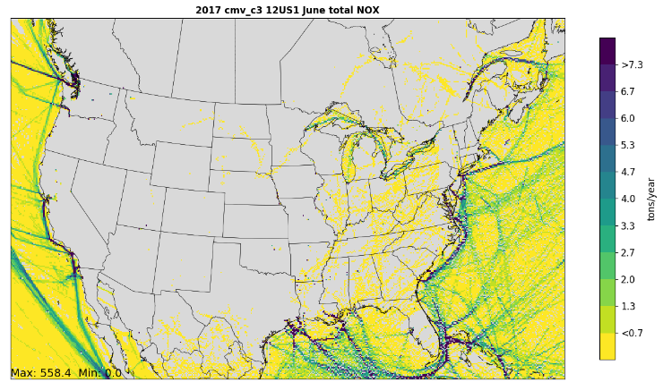
C3 Rasterization
36 Km Grid/hrly – Completed for CONUS
12 Km Grid/hrly – Completed for CONUS
QA inland data
Rasterization of Alaska & Hawaii - Underway
Initiate 36km/12km process for C1/C2
More refined area-specific grids – Under consideration
Preliminary 12km plot – still being quality assured

Slide 9
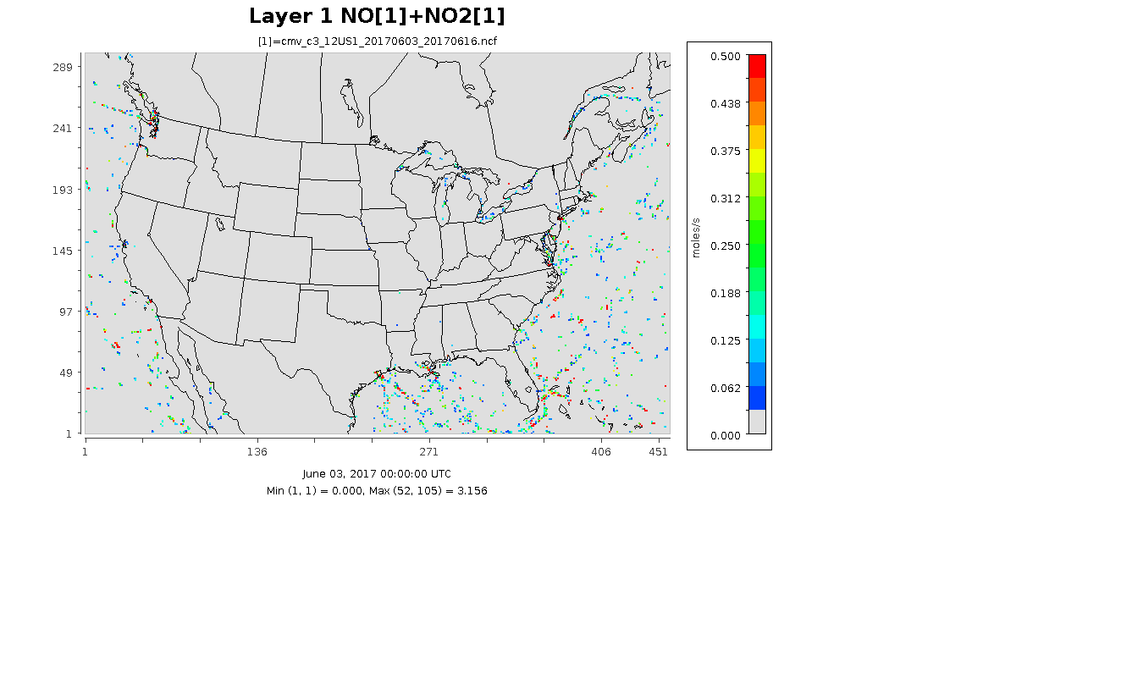
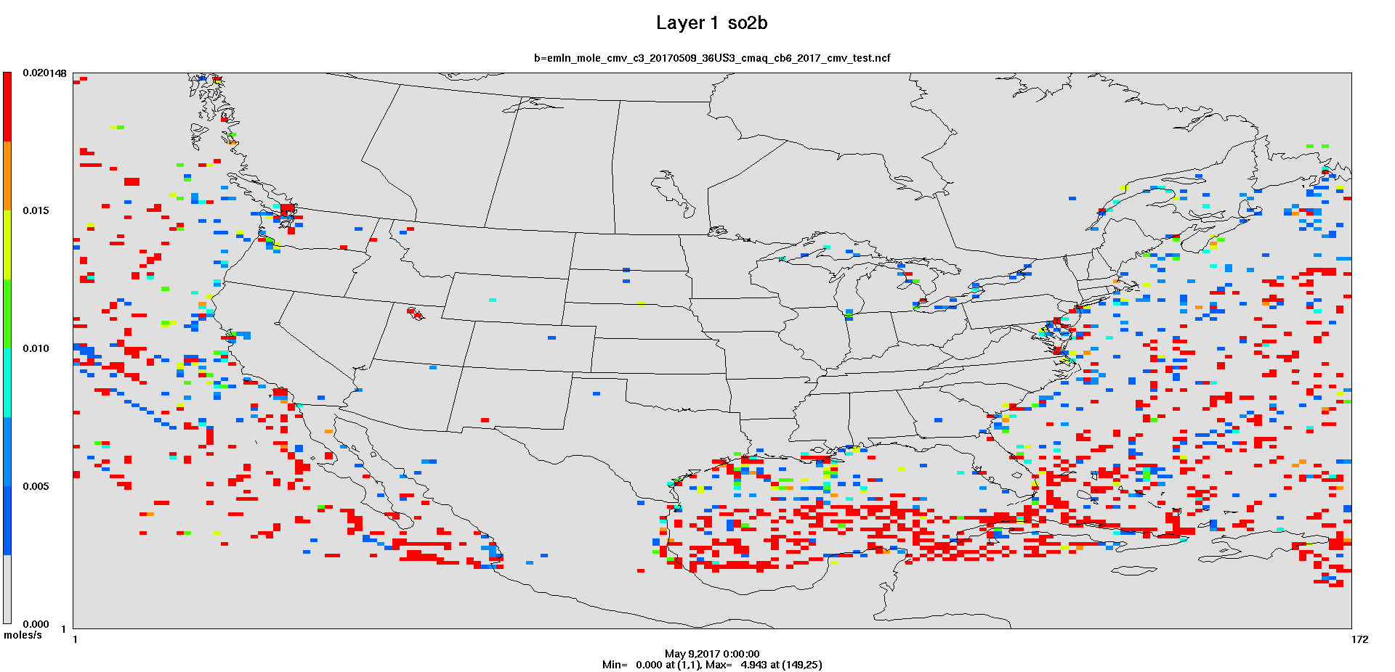
12km NOx and
36km SO2
Hourly Animations
(use slide show mode)

Slide 10
C1/2 Code completed
Activity Power Operating Load Duration
(kW-hr) = (kW) x Factor x (hrs)
Emissions Activity Emission Factor
(g/observation) = (kW-hr) x (g/kW-hr)

Slide 11
c1/c2 Vessel Attributes
Approximately 25% of the C1/2 vessels could be matched to Clarkson data - Power and speed data used as vessel-specific calculations
Where vessel specific data could not be used to calculate emissions, surrogate values were developed using:
  vessel type averages for matched Clarkson data
  gap filling with EPA port Guidance (e.g., aux load factors and boiler power ratings)

Slide 12
Default Auxiliary / Boiler values - updated
Vessel Group | Avg Build Year | Tier | Prop Power (kW) | Aux Power (kW) | Aux Operating Load | Boiler (kW)
Bulk Carrier | 1976 | 0 | 7505 | 1009 | 0.10 | 109
Commercial Fishing | 1987 | 0 | 520 | 567 | 0.56
Container Ship | 1994 | 0 | 2700 | 594 | 0.19 | 506
Ferry Excursion | 1995 | 0 | 5322 | 1385 | 0.56
General Cargo | 1986 | 0 | 2396 | 1120 | 0.22 | 106
Government | 1998 | 0 | 2125 | 2313 | 0.56
Miscellaneous | 1999 | 0 | 2337 | 1069 | 0.56
Offshore support | 1999 | 0 | 3949 | 1081 | 0.56
Pilot |  | 0 | 868 | 20 | 0.56
Reefer | 1992 | 0 | 5877 | 2854 | 0.32 | 464
Ro Ro | 1985 | 0 | 3793 | 695 | 0.26 | 109
Tanker | 2003 | 0 | 6578 | 2399 | 0.26 | 346
Tug | 1992 | 0 | 2395 | 162 | 0.56
Work Boat | 1989 | 0 | 3546 | 1492 | 0.56

Slide 13
C1/C2 Propulsion emission factors – updated
Model Year | Tier | NO_{x} | VOC | CO | PM₁₀ | PM_{2.5} | SO₂ | CO₂
Prior to 2004 | 0 | 13.36 | 0.14 | 2.48 | 0.210 | 0.204 | 0.006 | 679.47
2004-2006 | 1 | 10.55 | 0.14 | 2.48 | 0.210 | 0.204 | 0.006 | 679.47
2007-2012 | 2 | 8.33 | 0.14 | 2.03 | 0.309 | 0.300 | 0.006 | 679.47
2013-2016 | 3 | 6.35 | 0.08 | 2.03 | 0.200 | 0.194 | 0.006 | 679.47
2017+ | 4 | 1.30 | 0.02 | 2.03 | 0.111 | 0.107 | 0.006 | 679.47

Slide 14
C1 Aux / boiler emission factors - Updated
Model Year | Tier | NO_{x} | VOC | CO | PM₁₀ | PM_{2.5} | SO₂ | CO₂
Prior to 2004 | 0 | 10.28 | 0.30 | 1.61 | 0.259 | 0.251 | 0.006 | 679.47
2004-2006 | 1 | 9.62 | 0.30 | 1.61 | 0.259 | 0.251 | 0.006 | 679.47
2007-2012 | 2 | 5.64 | 0.30 | 0.92 | 0.148 | 0.144 | 0.006 | 679.47
2013-2016 | 3 | 4.75 | 0.12 | 0.92 | 0.083 | 0.080 | 0.006 | 679.47
2017+ | 4 | 1.30 | 0.12 | 0.92 | 0.030 | 0.029 | 0.006 | 679.47
Boilers | - | 2.00 | 0.11 | 0.20 | 0.200 | 0.190 | 0.590 | 961.80

Slide 15
HAP Profiles for all vessels using ECA compliant distillate fuels

Slide 16
CMV Emissions modeling
Process gridded data into hourly FF10
  Hourly by grid cell centroid allows for C3 plume rise
  Geocode centroids to populate FIPS
  Result ~1.2GB 12km FF10/~0.4GB 36km FF10 per month
Process through SMOKE
  Produce inline files with stack parameters
  ~30 min/month to process

Slide 17
Next steps
Complete QA checks on the C1/C2 data
Run C1/C2 code
Rasterize C1/C2 data
Develop C3 & C1/2 data for NEI annual emissions for NEI shape files
Developed rasterized data for specified areas ( Long Island, Great Lakes)
Reconcile C3 & C1/2 with Canadian inventory
Gapfill portions of 36km domain not covered by selection
Adjust 2017 Inventory for 2016
Documentation

